Slide 1
Team Ovarian
NLM Reproducibility in Bioinformatics Workshop
Sara Jones, Maarten Leerkes, Leo Meister
9/26/18

Slide 2
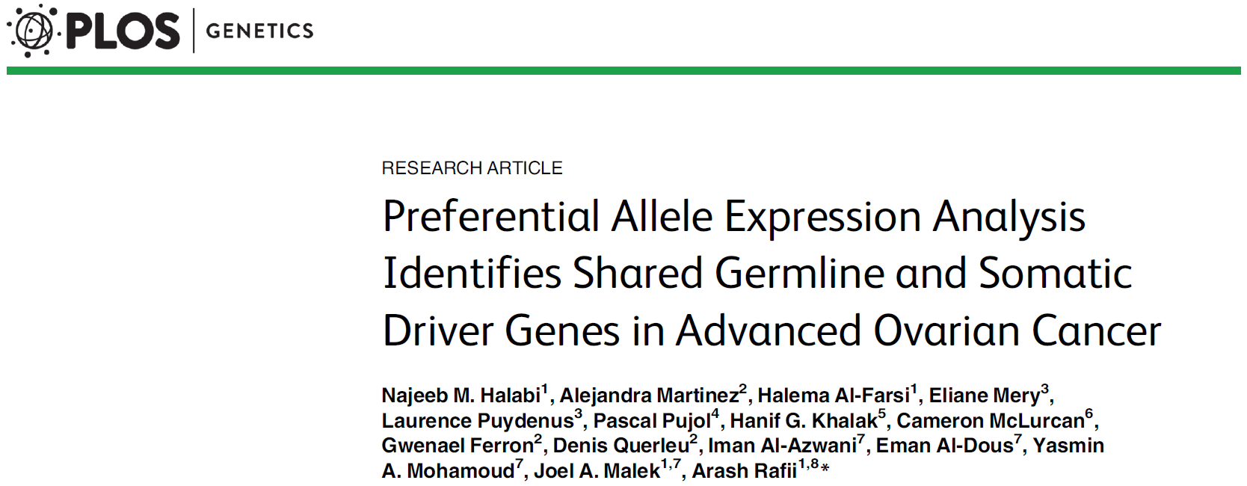

Slide 3
Our Goals in Reproducing the Paper
Reproduce software pipeline
Reproduce figures
Make our reproduction reproducible

Slide 4
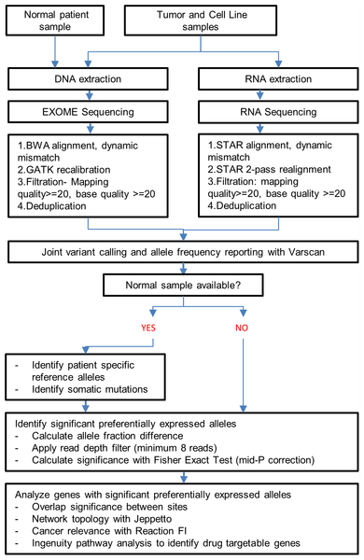

Fig 2. Schematic for global analysis of preferential allelic expression showing the steps followed for alignment, filtration, quality control and analysis steps.
Halabi NM, Martinez A, Al-Farsi H, Mery E, Puydenus L, et al. (2016) Preferential Allele Expression Analysis Identifies Shared Germline and Somatic Driver Genes in Advanced Ovarian Cancer. PLOS Genetics 12(1): e1005755. https://doi.org/10.1371/journal.pgen.1005755
https://journals.plos.org/plosgenetics/article?id=10.1371/journal.pgen.1005755

Slide 5
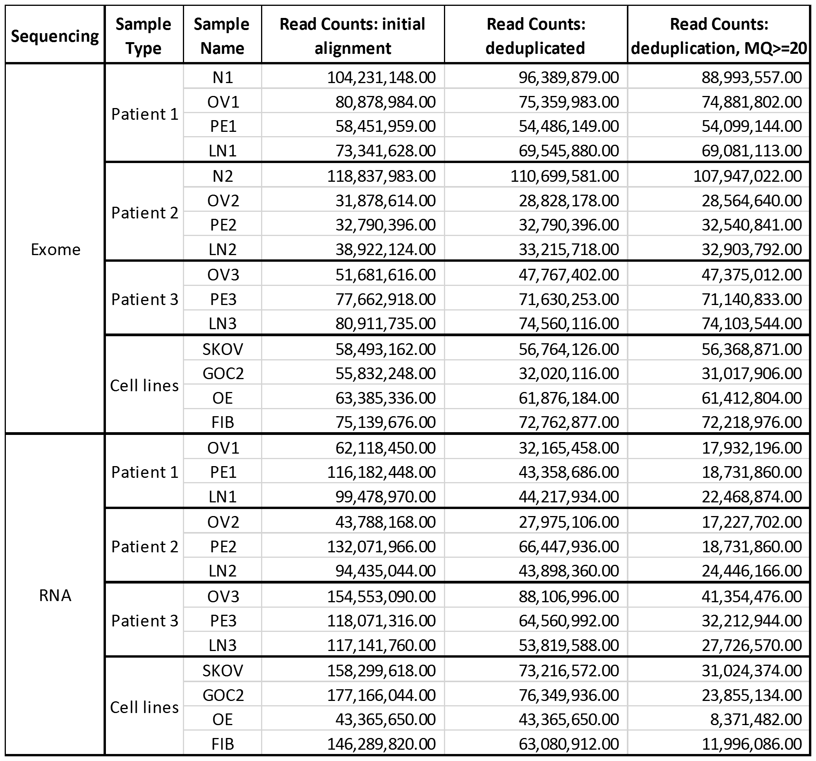
S1 Fig. Exome and RNA sequencing read counts

Slide 6
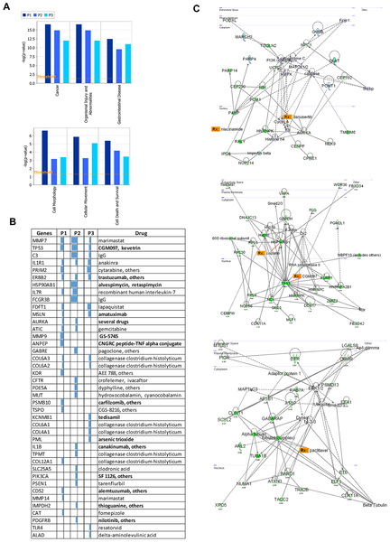
Fig 6. Patient specific analysis of negative RAD genes.
Halabi NM, Martinez A, Al-Farsi H, Mery E, Puydenus L, et al. (2016) Preferential Allele Expression Analysis Identifies Shared Germline and Somatic Driver Genes in Advanced Ovarian Cancer. PLOS Genetics 12(1): e1005755. https://doi.org/10.1371/journal.pgen.1005755
https://journals.plos.org/plosgenetics/article?id=10.1371/journal.pgen.1005755

Slide 7


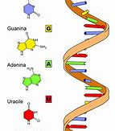

Slide 8
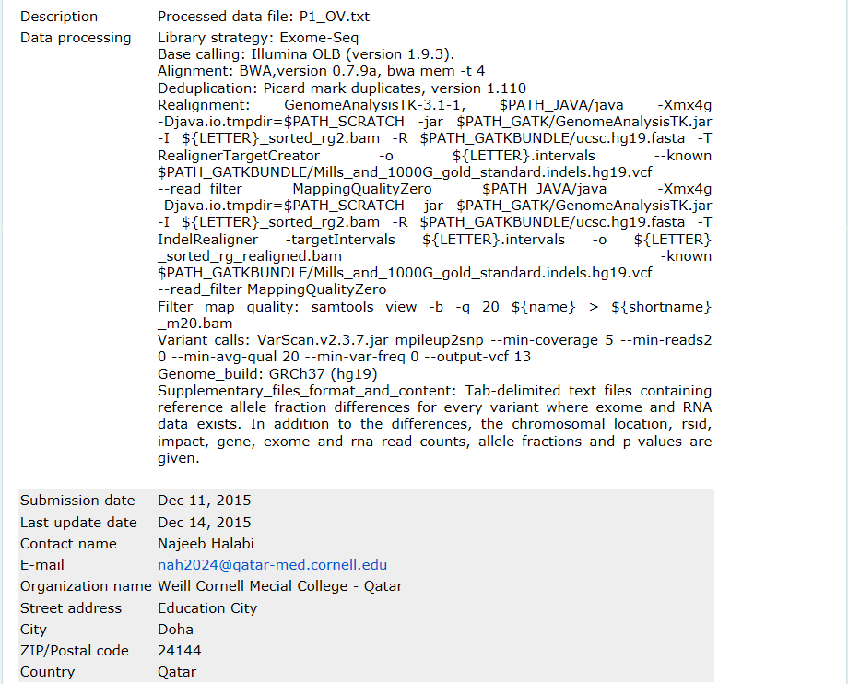

Slide 9
Challenges
Lack of bioinformatics expertise
Computing power
Reference gene file version
Docker on AWS
Software versioning and proprietary/custom software

Slide 10
What We Did

Slide 11
Results
Draft of workflow in Google Colab
Read counts from RNA-sequencing pipeline
Patient 1 (of 3), 1 tissue sample (of 4)
Ours: 17138624
Papers’: 17932196
~95% of their total reads

Slide 12
Next Steps
Work out GATK issues
Make Dockerfile with all software versions used in the paper
Finish pipeline and reproduction

